Slide 1
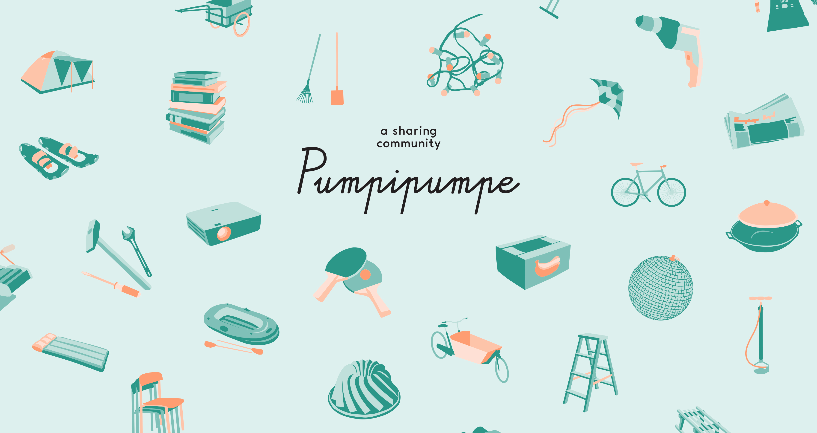
Notes:
Pumpipumpe - sharing community. Funded in 2012 in Bern, Switzerland.
Pumpipumpe promotes the sharing of everyday goods in urban neighborhoods.
Everyone does own a lot of things. And a lot of these things are only used by us from time to time or even rarely up until almost never. -> Potential of saving space in our apartments, money and resources if we use these rarely used things in a collaborative way.
Plus we so might meet nice neighbors and we can create/activate real, diverse, urban networks in our mostly anonymous urban neighborhoods.

Slide 2
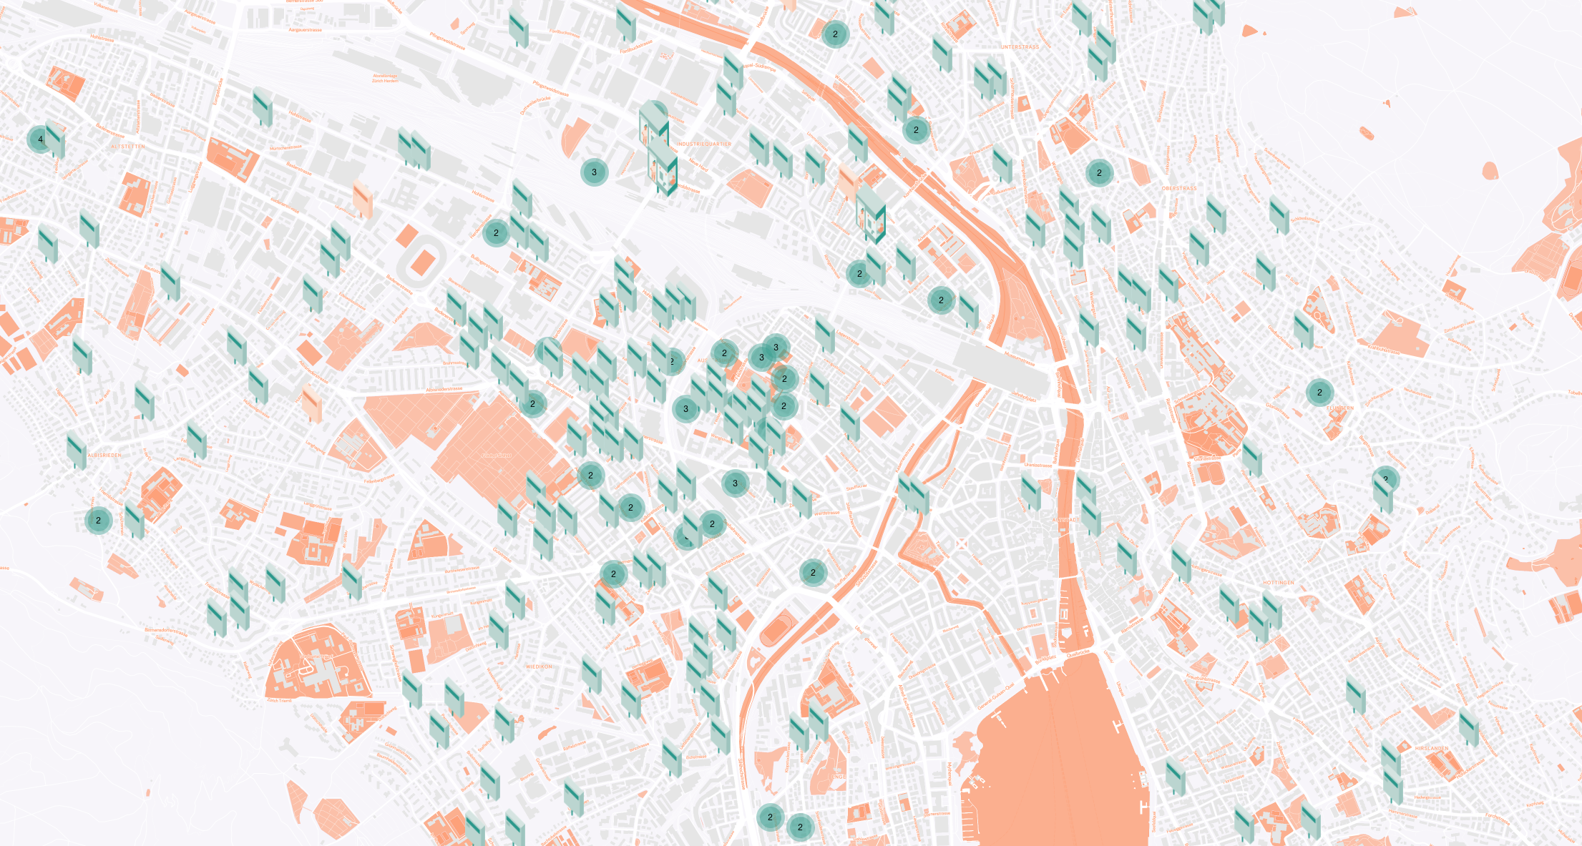
Notes:
If we think of how many objects, pasta machines, drilling machines, ladders etc we have in our city, or on like 200m2 in dense urban regions, we realize the abundance we actually life in.
Screenshot from the pumpipumpe online map: map.pumpipumpe.com
Image above: Zurich, March 2019
What if all these items or many of them could be visible to people living in these neighborhoods. what if these things would be accessible to them?

Slide 3
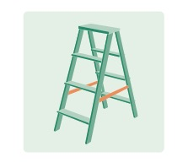
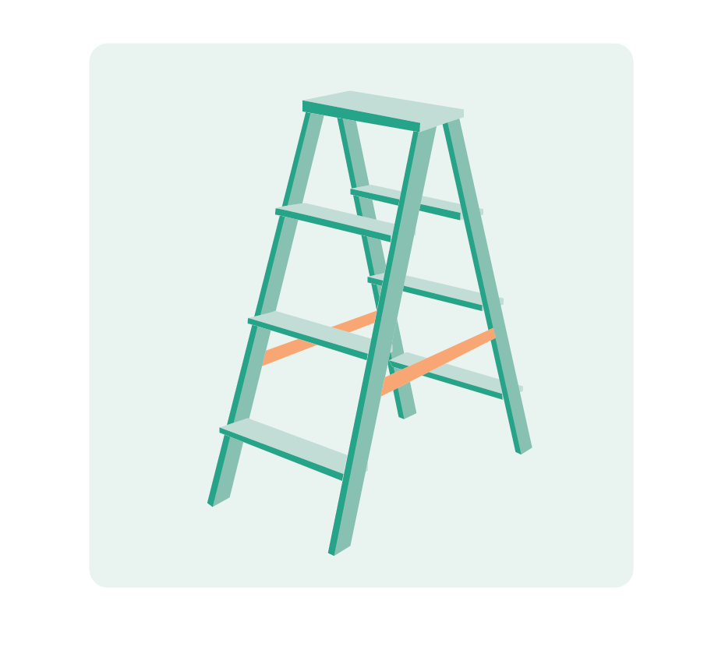
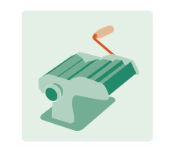
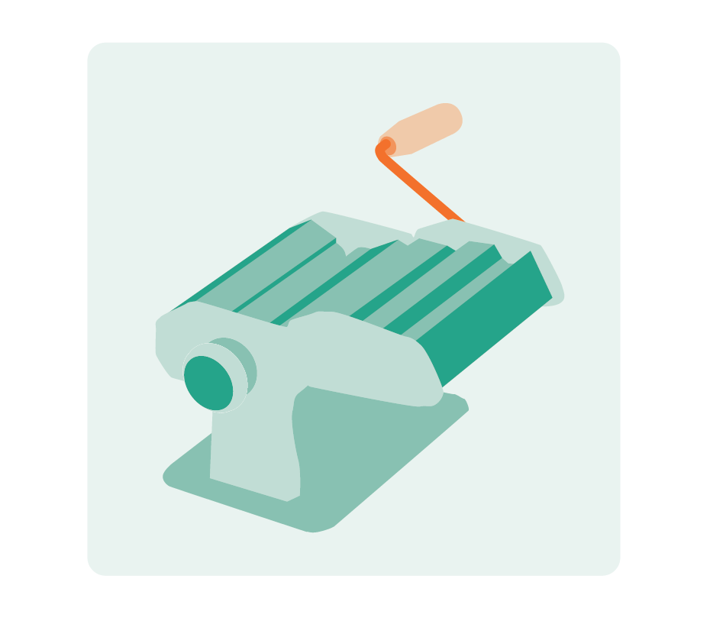
Notes:
Pumpipumpe wants to achieve exactly that: making these objects visible, accessible, exchangeable

Slide 4
Notes:
Pumpipumpe wants to connect people, to connect neighbors.

Slide 5
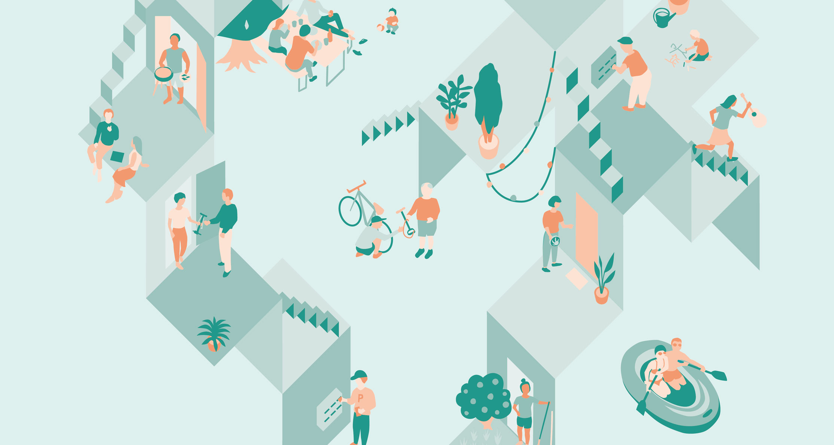
Notes:
Pumpipumpe wants to create lively urban neighborhoods.

Slide 6
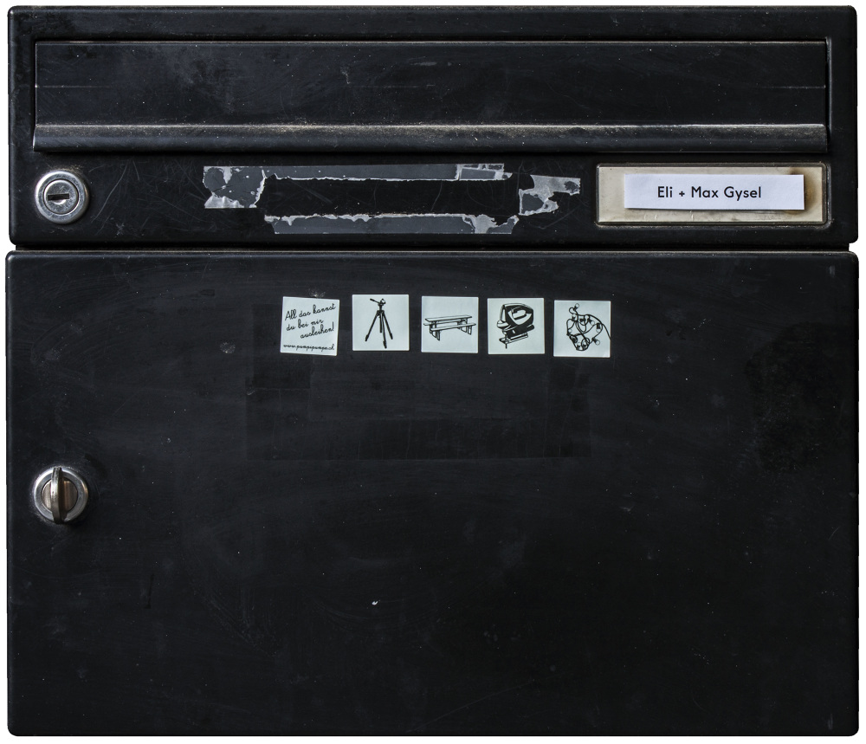
Notes:
Pumpipumpe does this by distributing stickers with illustrations of everyday objects, people mostly only use from time to time.
People can order these stickers on the website and then apply them to their mailbox.
Mailboxes are existing infrastructure Pumpipumpe uses as a personal public interface for super local communication. to make the project work in an easy way but also to keep the topic of sharing present in everyday life, in the neighbors real daily environment.
Mailboxes are very visible to the direct neighbors and the stickers communicate the idea of Pumpipumpe very visually to people across ages and beyond language barriers. Much more present in daily life than an app.

Slide 7
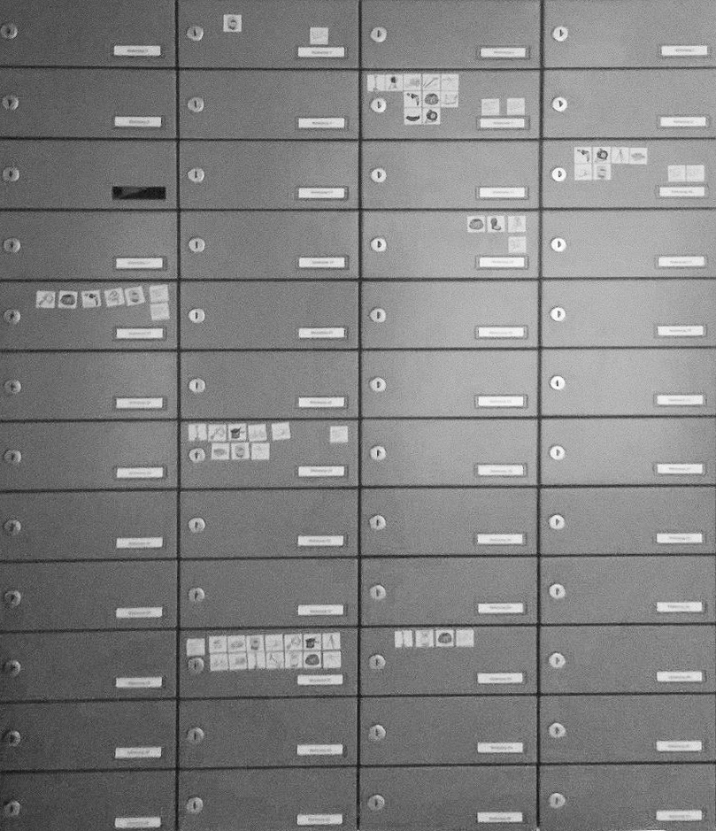
Notes:
More than 24‘000 households do participate in Pumpipumpe a sharing community so far all across Europe. Mainly in Switzerland, Germany, Austria and France.
And so over 150000 objects are available already for free to borrow from kind neighbors.
It is a very simple project. But a lot of things do stay unclear in this project. We regularly receive questions like: what do I actually do if someone actually comes and rings and wants to borrow something…
Is there guidelines? Insurances? What do I do? Whom can I trust? Without online ratings
And that is exactly what we want do trigger. We do not see Pumpipumpe as a consumer ready product, but rather a tool. That can be used to initiate awareness of our consumer habits, initiate social interaction in urban neighbourhoods. Can initiate cange the way we cosume, own, use things. But what we do with that, where we go from there is up to every participant. Whom we want to shift from a role as a consumer to an creative activist. Who asks questions and starts designing his own way of interacting with objects and humans around.

Slide 8
Notes:
Pumpipumpe wants to activate urban potential with a tool neighbors can use to shape their environment themselves in an easy way.
In the future more people will life in citys, in dense areas. Pumpipumpe thinks it is important to see and work on positive aspects of these circumstances.
Especially in the age of digitalization and the growth of digital global networks that connect us with mostly likeminded people from all over the world. Pumpipupe believes in the importance of the diverse local real networks and so wants promote the exchange and collaboration with neighbors from different cultural and political backgrounds.
Pumpipumpe hopes that in the future people will buy less (only what they use frequently) and share these things with friendly neighbors from time to time.

